Slide 1
CONTROL OF SLUICE GATE USING DECISION TREE ALGORITHM
Presented By:
Vinayak Jaiwant(2KL17CS104)
Yash Vidhate(2KL17ME102)
Krishna Pai(2KL17EE016)
Basamma Katti(2KL17CV015)
Under the guidance of :
Dr. R. V. Raikar

Slide 2
Abstract
A dam is primarily constructed for the purposes of power generation and irrigation.
While the two primary purposes are acknowledged, the role of damsin flood control has invariably been underestimated.
We present an automated system to control the sluice gates in dams using artificial intelligence to address the roles of control and management.
As rainfall is very difficult to predict, if the water level increases drastically due to heavy rainfall it results in floods.
By introducing predictive models and statistical analysis, we will be able to predetermine the heavy rainfall and hence control the water level in reservoir.

Slide 3
Objectives
Survey and analysis of the currently employed methodology.
Real time testing and analysis for better optimization.
To reduce the operational errors by automating the process.
To introduce a automated system with continous feedback loop.
To reduce the floods by regulating the discharge.

Slide 4
Methodology
Collection and analysis of previous year rainfall data.
Predict the rainfall based on the present dynamic conditions.
The predicted rainfall value is checked for the safety of dam and it's reservoir capacity.
The sluice gates are hoisted for water to discharge to maintain the water level below the safety measures.
The discharge may be optimized for the maximum power production at various loads.

Slide 5
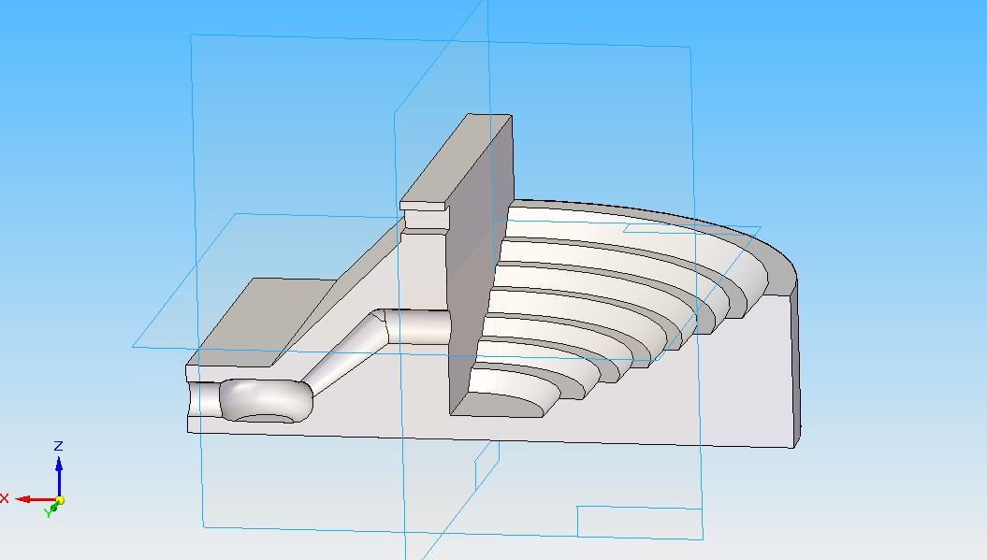

Slide 6
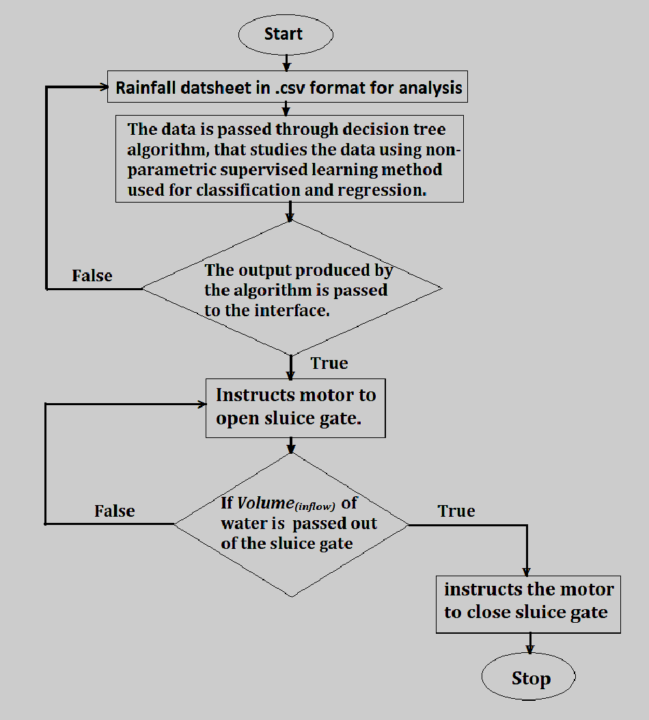
Flow chart

Slide 7
Market survey
Water management systems in India are managed by the department of Irrigation under Government of India.
The local dam storage and its rotation through canals is looked after by state government.
Depending upon on the capacity of dam, if the capacity exceeds 90% its total storage capacity then the water is released through spillway and canals for the safety measures of the dam.
Depending upon the need of the utilizing agencies like Gram Panchayat, Municipal Councils and water lifting society who pay charges for raw water utilization, the seasonal rotation pattern has been decided by irrigation department.
The raw water charges for the drinking water purposes are approx. 15 Rs./1000 liters. The beneficiary are a measure consideration for the discharge of water through the spillways.

Slide 8
Sr.no. | Month | Action plan
1. | January | Collection of data and purchasing materials required.
2. | February | Preparing a miniature structure of dam and its surroundings.
3. | March | Preparing a miniature structure of dam and its surroundings.
4. | April | Connecting electrical and electronics components to the model.
5. | May | Connecting electrical and electronics components to the model.
6. | June | Algorithms and programming development stage.
7. | July | Interfacing electrical and electronics components to program.
8. | August | Combining all the parts and making it work simultaneously.
9. | September | Testing of the whole miniature structure.
10. | November | Calibration and finishing.
11. | December | Model ready for simulation .

Slide 9
Costing(Budget estimation)
Sl. No. | Components | Amount in Rs.
1. | Telemetry Equipment | ₹ 50,000/-
2. | Hoisting Mechanism | ₹ 50,000/-
3. | Hardware and Wiring | ₹ 30,000/-
4. | Monitoring System | ₹ 30,000/-
5. | Miscellaneous | ₹ 50,000/-
Total (Approx.) |  | ₹ 2,10,000/-

